Slide 1

Recommender system using collaborative filtering
School of IT and Engineering
CSCI4734 Machine Learning
Summer 2025
Team 3
Javad Taghiyev BSCS
Mahbuba Jafar BSCS
Nasib Pashayev BSCE

Slide 2
Agenda
Problem Statement
Data
Model(s)
Results
Considerations

Slide 3
Project in a Slide
Project Title | Recommender System using Collaborative Filtering
Value | Provides personalized game recommendations to users based on their gaming history and similar users' preferences, enhancing user engagement and game discovery on digital gaming platforms.
Problem type | Collaborative filtering, matrix factorization, recommendation system, unsupervised learning
Original and final data shape | E.g., original – 200000x5, final – 12000x8500 (after filtering and creating user-item matrix)
Preprocessing steps | Data filtering (play actions only), log1p transformation of playtime, user-game ID mapping, user-wise train-test split (80-20), sparse matrix construction
Model(s) | Matrix Factorization algorithm implemented through ALS (Alternating Least Squares) model
MLOps tool
Evaluation metric | RMSE (Root Mean Square Error) and MAE (Mean Absolute Error) on held-out test set
Best score(s) | Grid search optimized RMSE and MAE values with optimal hyperparameters (factors: 10-20, lambda: 0.01-0.1, iterations: 5-10)
Interpretation | The ALS model successfully learns latent user preferences and game characteristics, enabling effective collaborative filtering. Performance compares favorably to baseline recommendation approaches, with convergent training demonstrating effective matrix factorization learning for personalized game recommendations.

Slide 4
Contributions
Team Member | Contribution
Javad Taghiyev | 33%
Mahbuba Jafar | 33%
Nasib Pashayev | 33%

Slide 5
Problem Statement
Challenge: Digital gaming platforms struggle to help users discover relevant games from vast catalogs, leading to poor user engagement and missed revenue opportunities.
Objective: Develop a personalized game recommendation system that predicts user preferences for unplayed games based on historical gameplay data.
Approach:
Task Type: Collaborative Filtering Recommendation System
Method: Matrix Factorization using Alternating Least Squares (ALS)
Data: Implicit feedback from user playtime behaviors
Goal: Generate top-N personalized game recommendations
Key Questions:
How can we learn latent user preferences from gameplay patterns?
What games should we recommend to users based on similar users' behaviors?
How accurate can our predictions be for user-game preferences?

Slide 6
Data
Dataset: Steam-200k Gaming Dataset
Source: User-game interaction data from Steam gaming platform
Original Shape: ~200,000 records × 5 columns
Columns: user_id, game, action, playtime, unused_column
Data Preprocessing Pipeline:
1. Data Filtering & Cleaning
Filtered for "play" actions only
Removed zero playtime entries
Retained meaningful user-game interactions
2. Feature Engineering
Applied log1p transformation: log_playtime = log(1 + playtime)
Handles skewed playtime distribution
Improves model stability and convergence
3. Data Mapping
Created user_id ↔ index mappings
Created game_id ↔ index mappings
Enabled efficient matrix operations
4. Train-Test Split
User-wise splitting (80-20 ratio)
Ensures each user appears in both sets
Maintains realistic evaluation scenario
Final Data Shape: User-Item matrix (num_users × num_games) with log-transformed playtime values

Slide 7
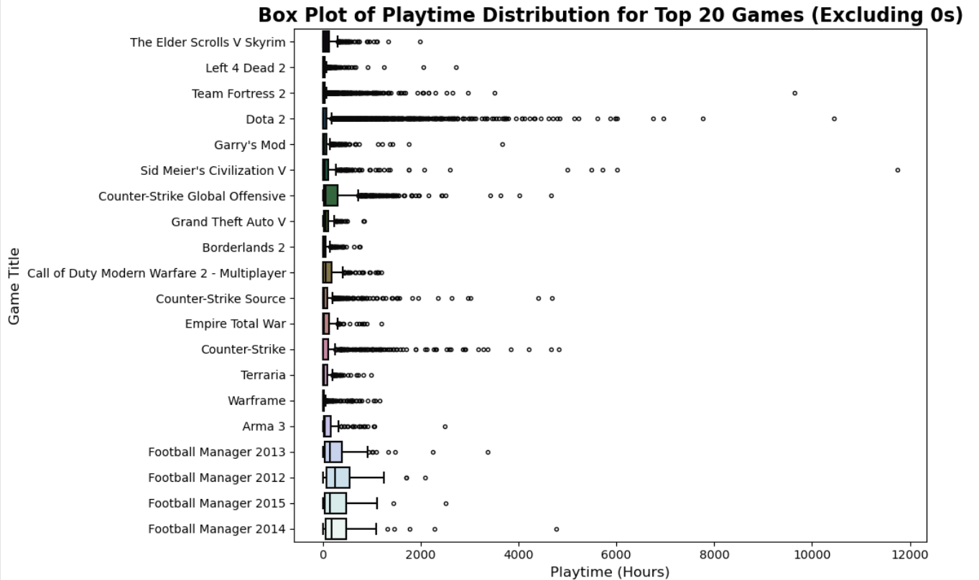
Raw data

Slide 8
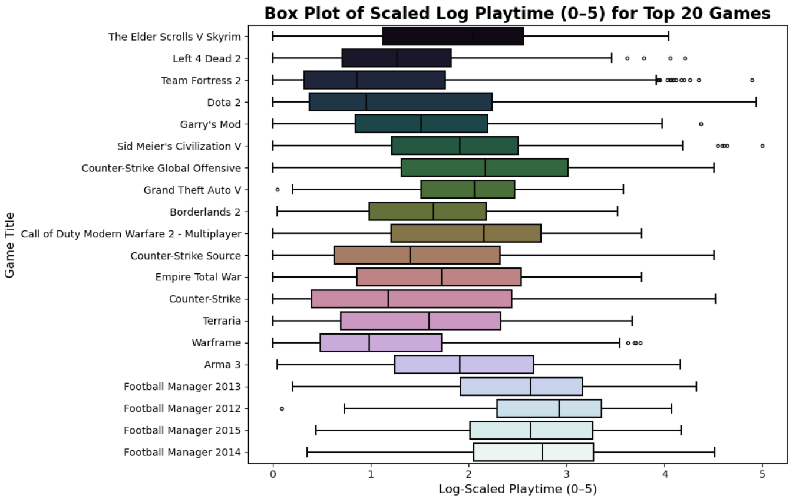
Processed data

Slide 9
Model(s)
Algorithm: Matrix Factorization for Collaborative Filtering
Decomposes user-item interaction matrix R into latent factors
R ≈ U × V^T where U = user factors, V = item factors
Captures hidden patterns in user preferences and game characteristics
Model: Alternating Least Squares (ALS)
Why ALS?
Handles implicit feedback (playtime) effectively
Computationally efficient through alternating optimization
Avoids gradient descent complexity with closed-form solutions
Well-suited for sparse recommendation data
Model Architecture:
User Matrix U: (num_users × k) latent factors
Item Matrix V: (num_games × k) latent factors
Prediction: score = U[user] · V[game]
Training Process:
Fix V, optimize U: Solve least squares for each user
Fix U, optimize V: Solve least squares for each game
Repeat: Until convergence
Hyperparameters:
Latent factors (k): 10, 20
Regularization (λ): 0.01, 0.1
Iterations: 5, 10

Slide 10
Results
Grid Search Performance:
Systematic hyperparameter optimization across factors, regularization, and iterations
Different optimal settings for RMSE vs MAE metrics
Model Convergence:
Training RMSE decreased consistently across iterations
Stable ALS optimization and factor learning
Recommendation Quality:
Generated meaningful top-N game recommendations
Successfully personalized based on collaborative patterns
Properly filtered previously played games
Evaluation Metrics:
Test RMSE and MAE on held-out data
Competitive performance for collaborative filtering
Key Findings:
Matrix factorization captures user-game relationships effectively
ALS converges reliably
System produces practical personalized recommendations

Slide 11
Considerations
Limitations:
Cold Start Problem: New users/games lack interaction history
Data Sparsity: Limited coverage for inactive users
Scalability: Matrix operations expensive for large datasets
Evaluation Gaps:
Missing recommendation metrics (Precision@K, Recall@K)
No baseline comparisons or diversity assessment
Technical Challenges:
Hyperparameter sensitivity affects performance
Overfitting risk requires careful regularization
Memory requirements for large matrices
Future Improvements:
Hybrid Methods: Combine with content-based filtering
Advanced Models: Deep learning approaches
Better Evaluation: Ranking metrics and user studies
Deployment Considerations:
Real-time serving architecture
Periodic model retraining
A/B testing framework

Slide 12
THANK YOU FOR YOUR ATTENTION!
Questions?

